Slide 1

Fastest growing Real Estate Markets
Alex Burch Abdurrahman Darvesh Sean Findley Rodney Kirkendoll serena leung Roderick Reynolds Jamie thorpe

Slide 2
Proposal & research question
Our client is a real estate developer interested in figuring out which market to invest in that will have the highest growth potential. We will look at population growth over the course of five years, income, and poverty levels.
Question: Which market had the highest recent growth in per square foot prices?
Which market had the least amount of growth?

Slide 3
Hypothesis vs. alternative hypothesis
Null Hypothesis
Alternative Hypothesis
There is no relationship between population growth or income and price growth.
Cities that have the highest population growth will have the highest price growth potential.
Cities that have higher income levels correspond to real estate with higher prices.

Slide 4
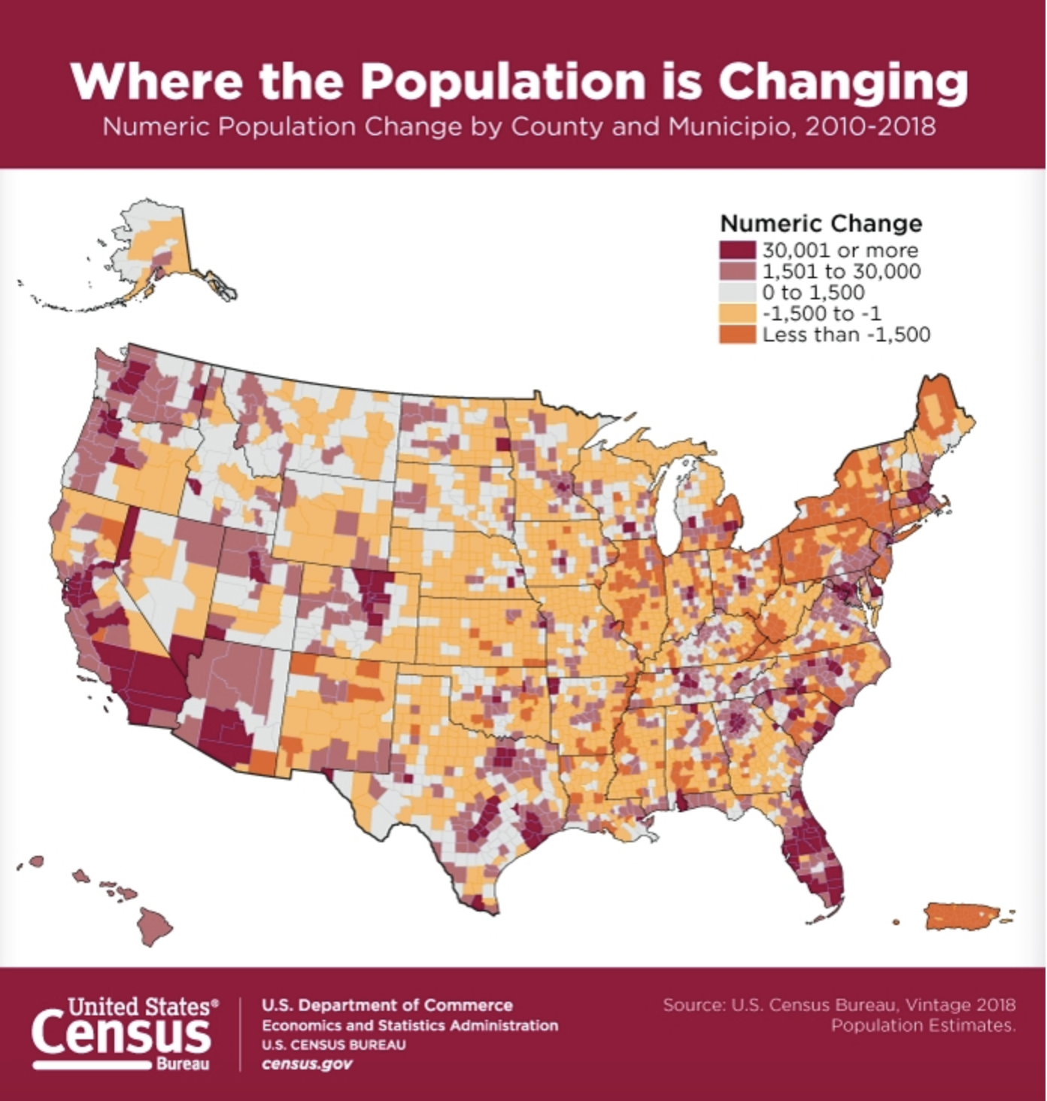
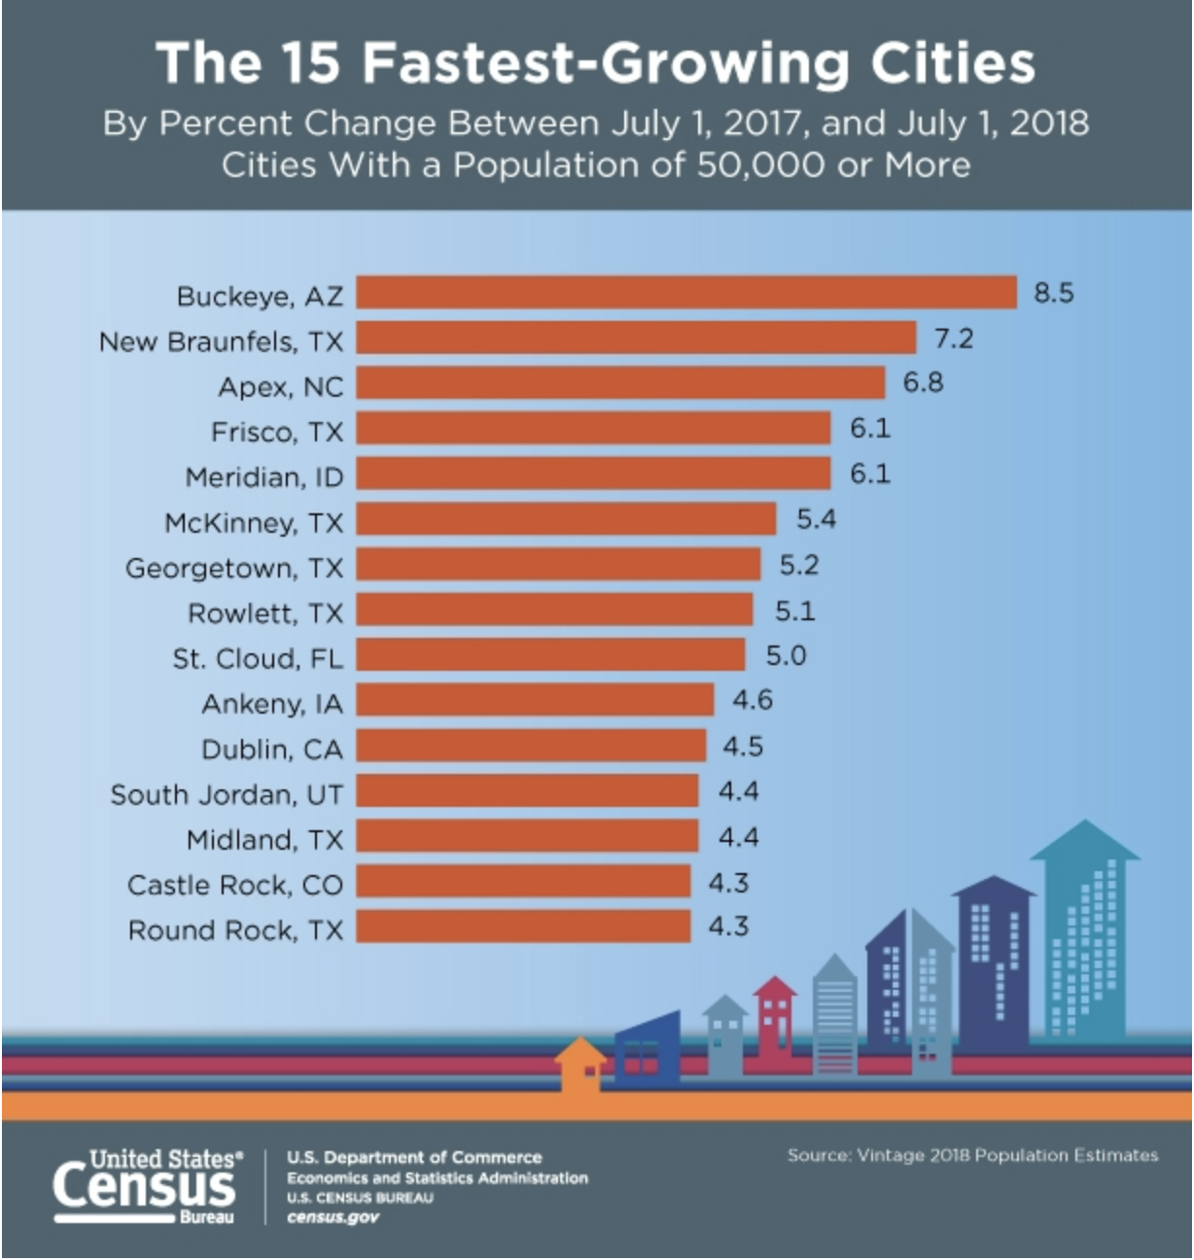
High Population Increases In Fl, WA, CA
Source: US Census Bureau. Fastest growing cities: https://www.census.gov/library/visualizations/2019/comm/15-fastest-growing-cities.html
Source: US Census Bureau. Population change by county: https://www.census.gov/library/visualizations/2019/comm/num-pop-change-county.html

Slide 5
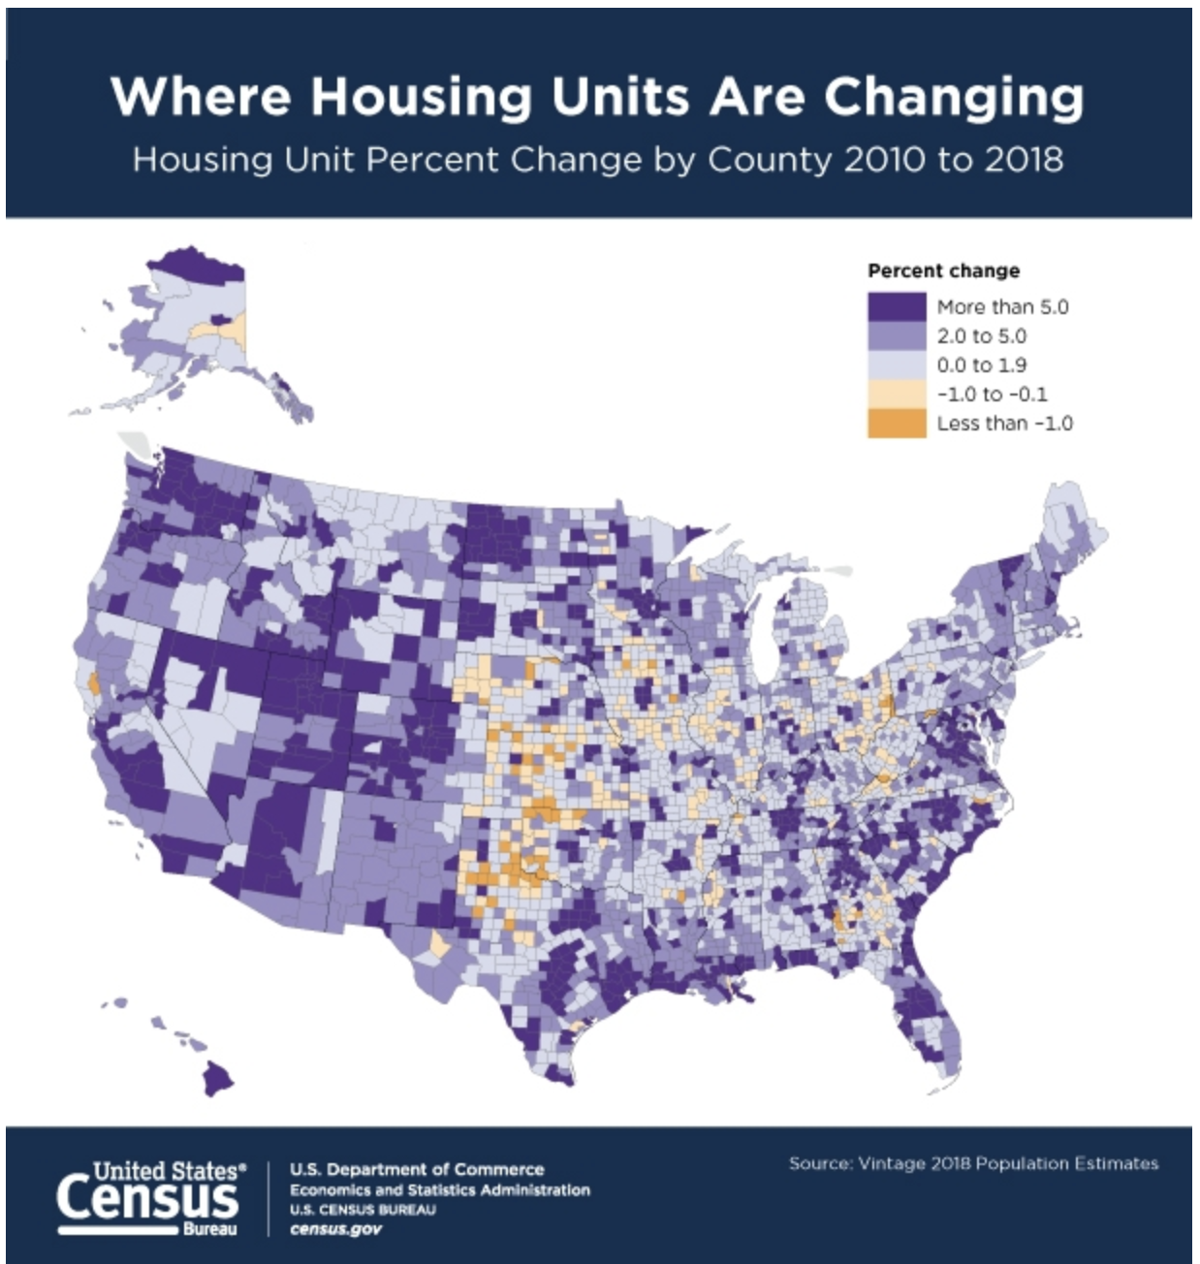
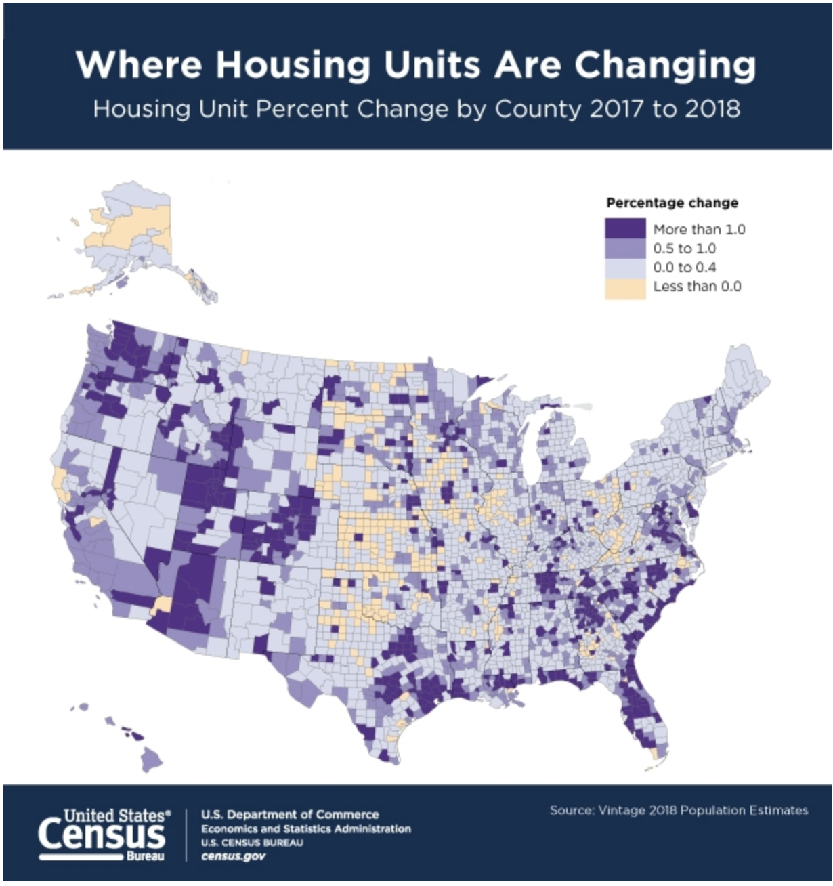

Housing Units are increasing in AZ, UT, CO, FL
Source: US Census Bureau: https://www.census.gov/library/visualizations/2019/comm/housing-unit-change-2010-2018.html
Source: US Census Bureau: https://www.census.gov/library/visualizations/2019/comm/housing-unit-change-2017-2018.html

Slide 6
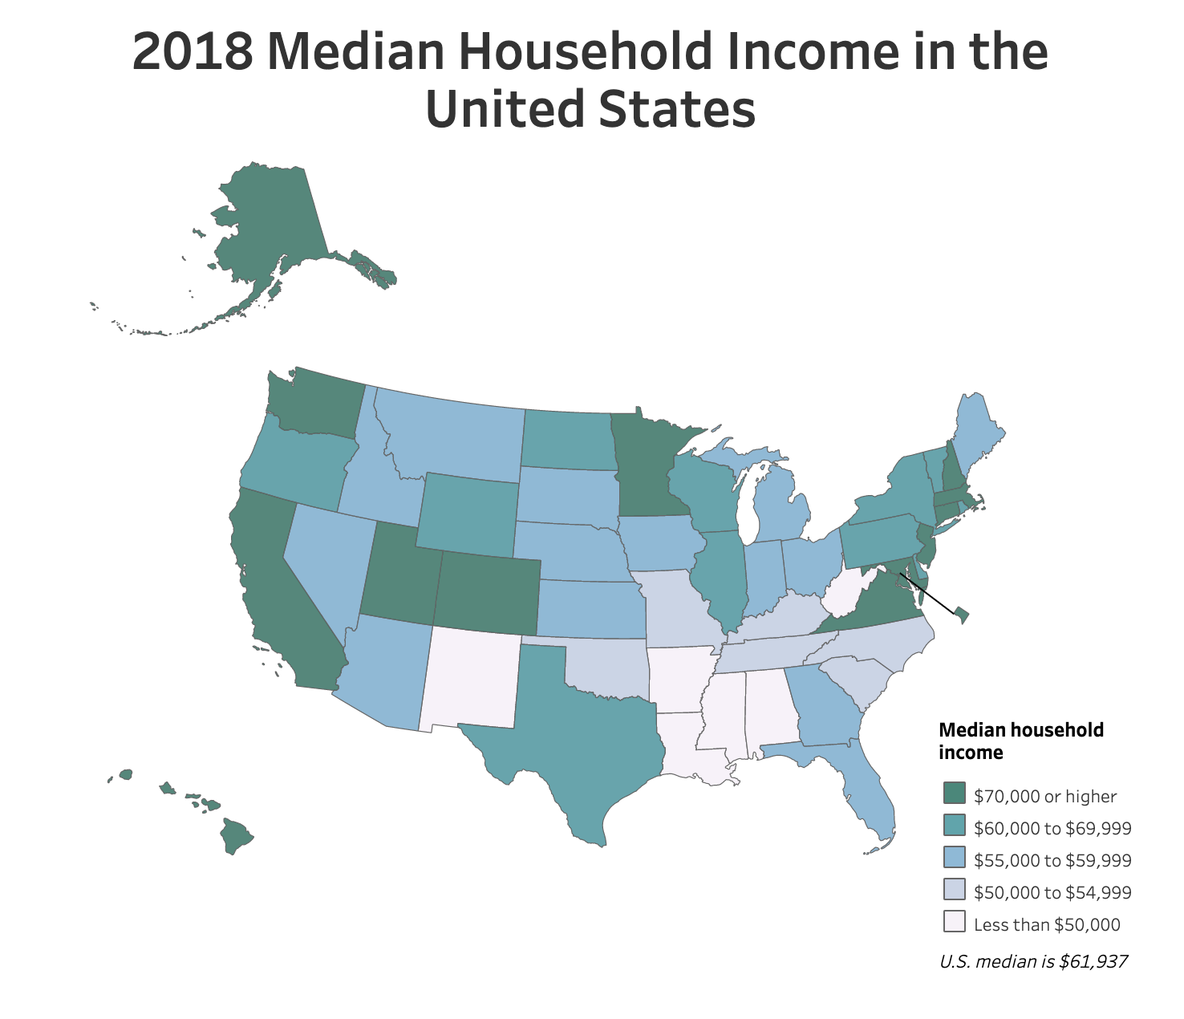
Median household income is highest in CA, WA, UT, CO, IL, northeast
Source: US Census Bureau. Median Household income By State: https://www.census.gov/library/visualizations/interactive/2018-median-household-income.html

Slide 7
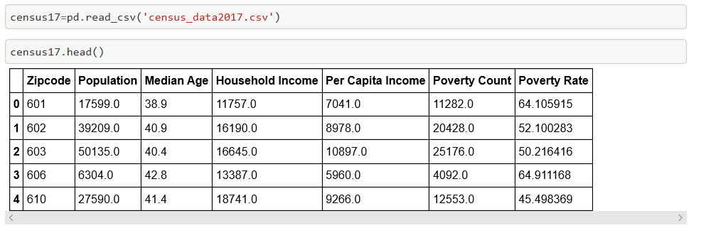
Coding approach & Data Munging
Census data from years 2012-2017 were used to calculate correlations between:
Zip codes
Population
Median Age
Household income
Per Capita Income
Poverty count
Poverty Rate
Statistics were then summarized for 2017

Slide 8
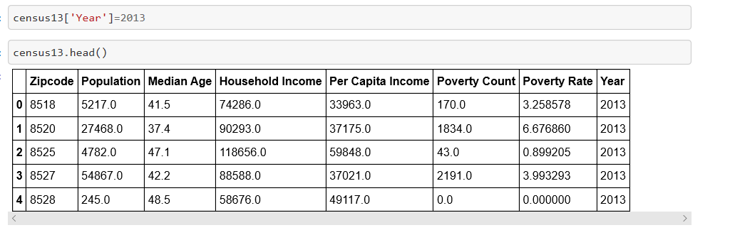
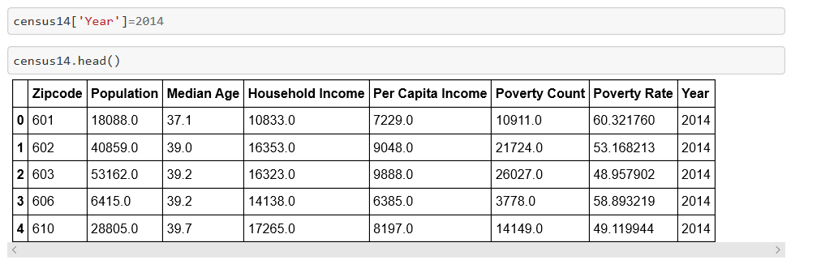
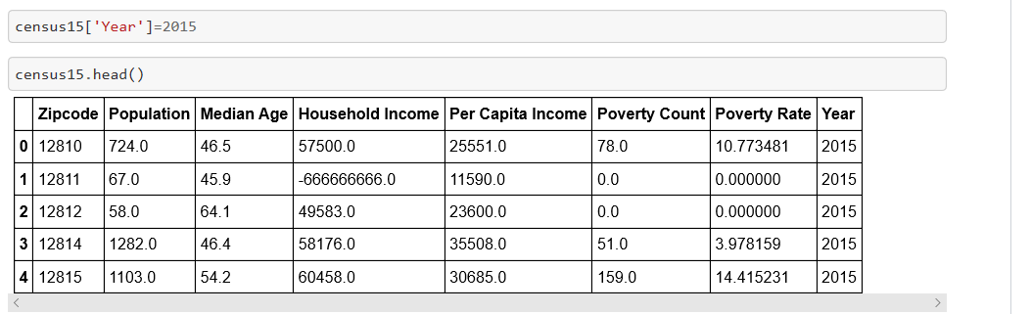
Additional data munging

Slide 9
Visualization approach
Our client can use the census data we pulled in the ETL project to look at population and income change over the last 5 years.
Our client can also look at percentage change in income on a year-to-year basis to see which zip code had the highest percentage growth.

Slide 10
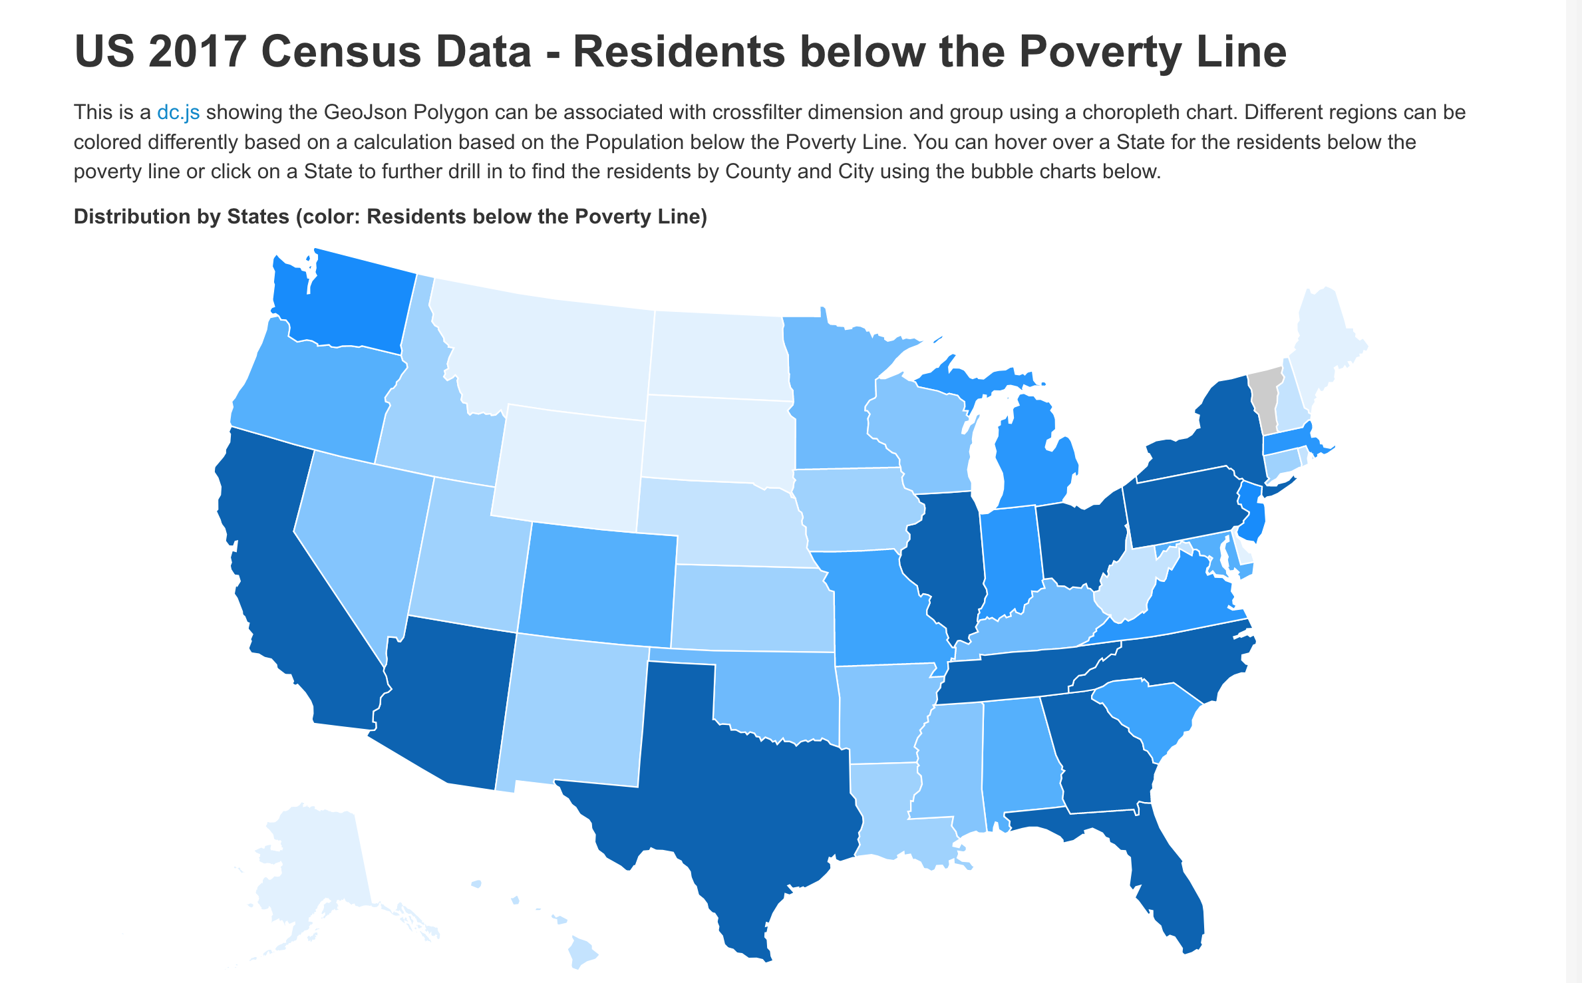
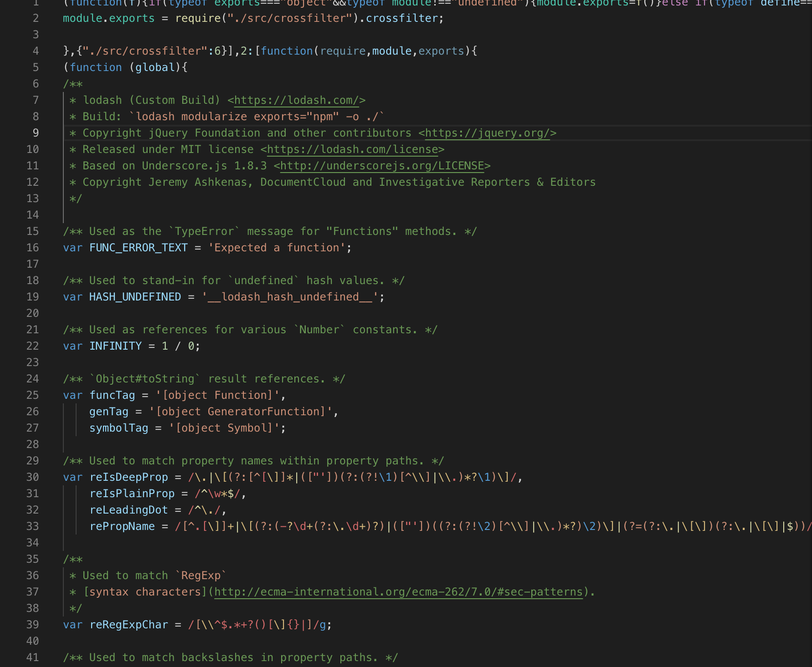
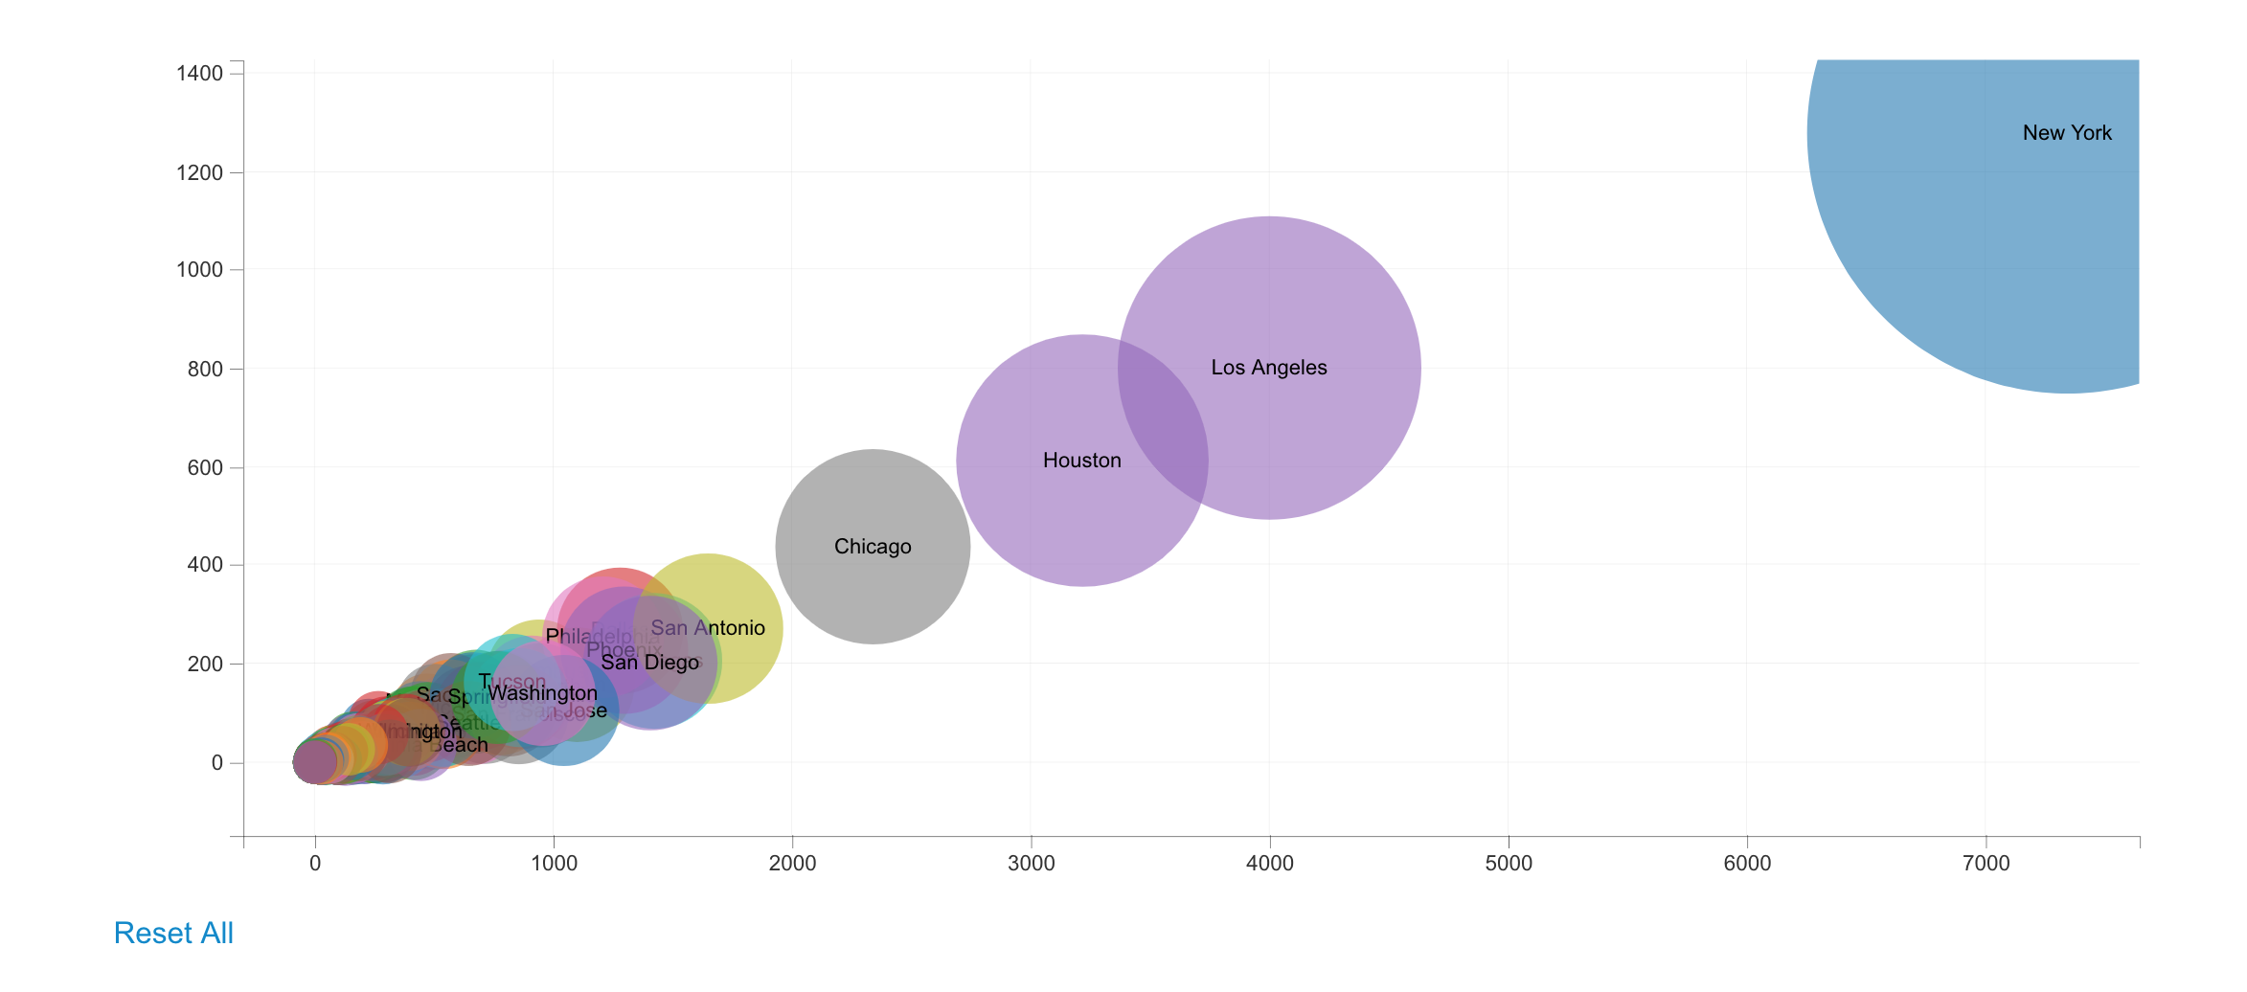
Visualization One
The Choropleth map at the state level that interacts with the bubble chart displaying the city and county with poverty count. The y-axis is an aggregate count.
Utilized GeoJSON Polygon, dc.js, Choropleth map, crossfilter.js…

Slide 11
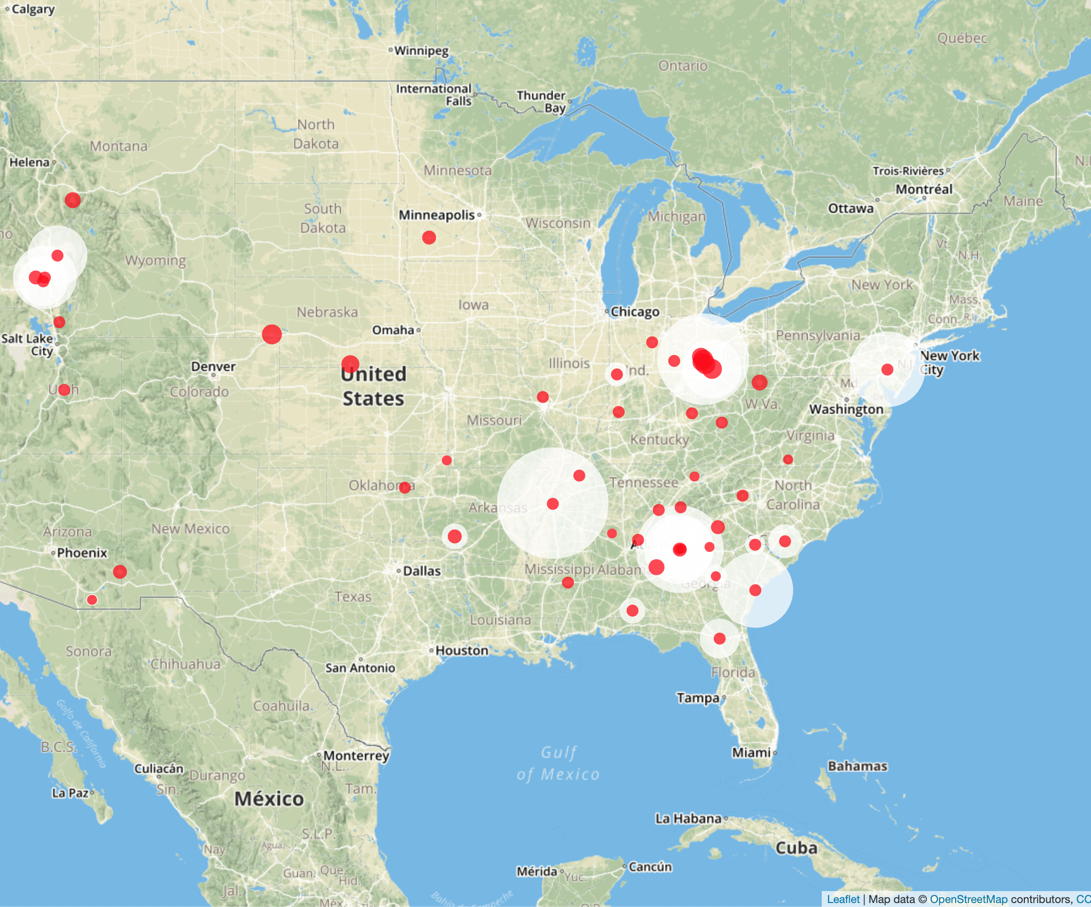
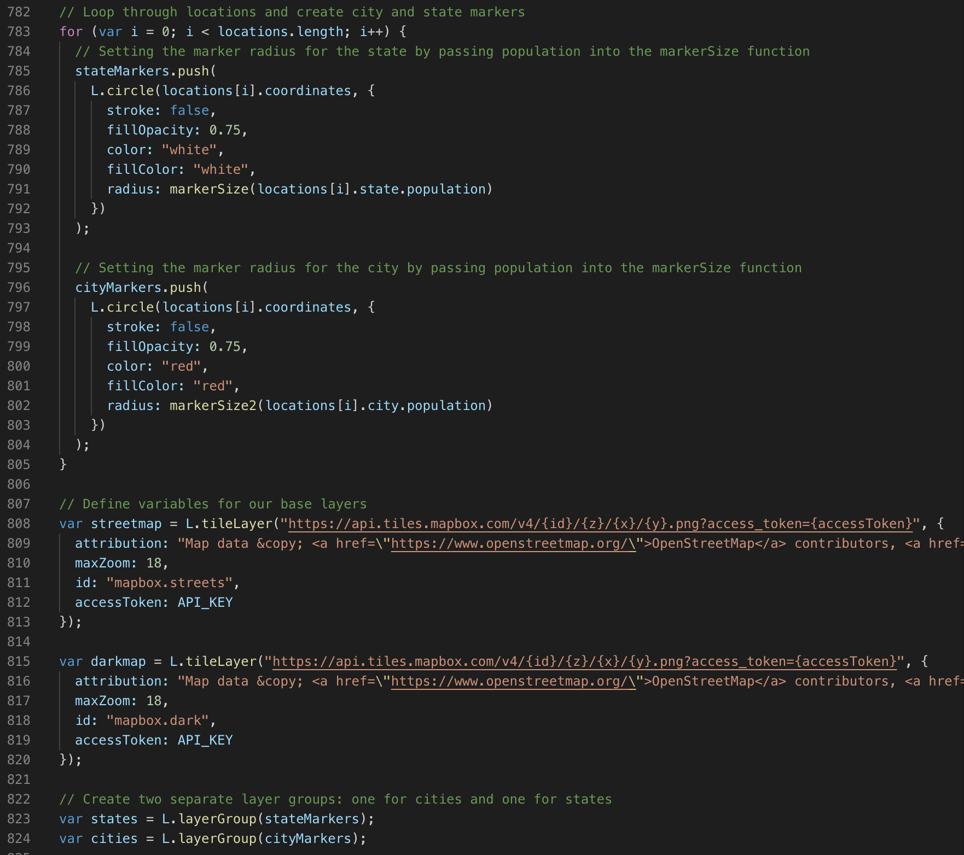
Visualization TWO
Map displays the zip codes with Avg percentage change in per square foot price. This is addressing the hypothesis so that our investors know which markets to invest in.
Have 2 layers: cities and states
Utilized JS, Dark Mode,…

Slide 12
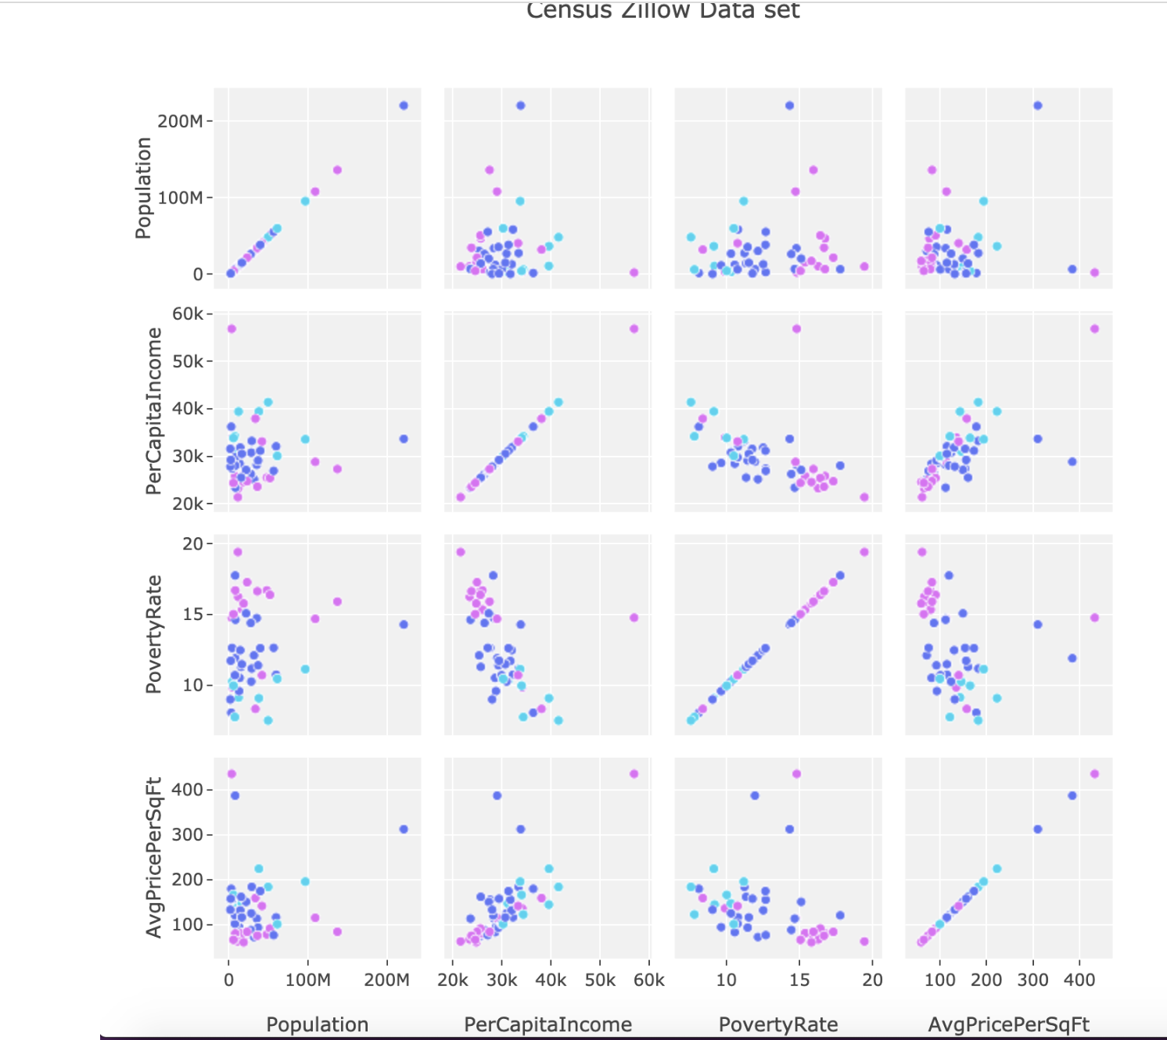
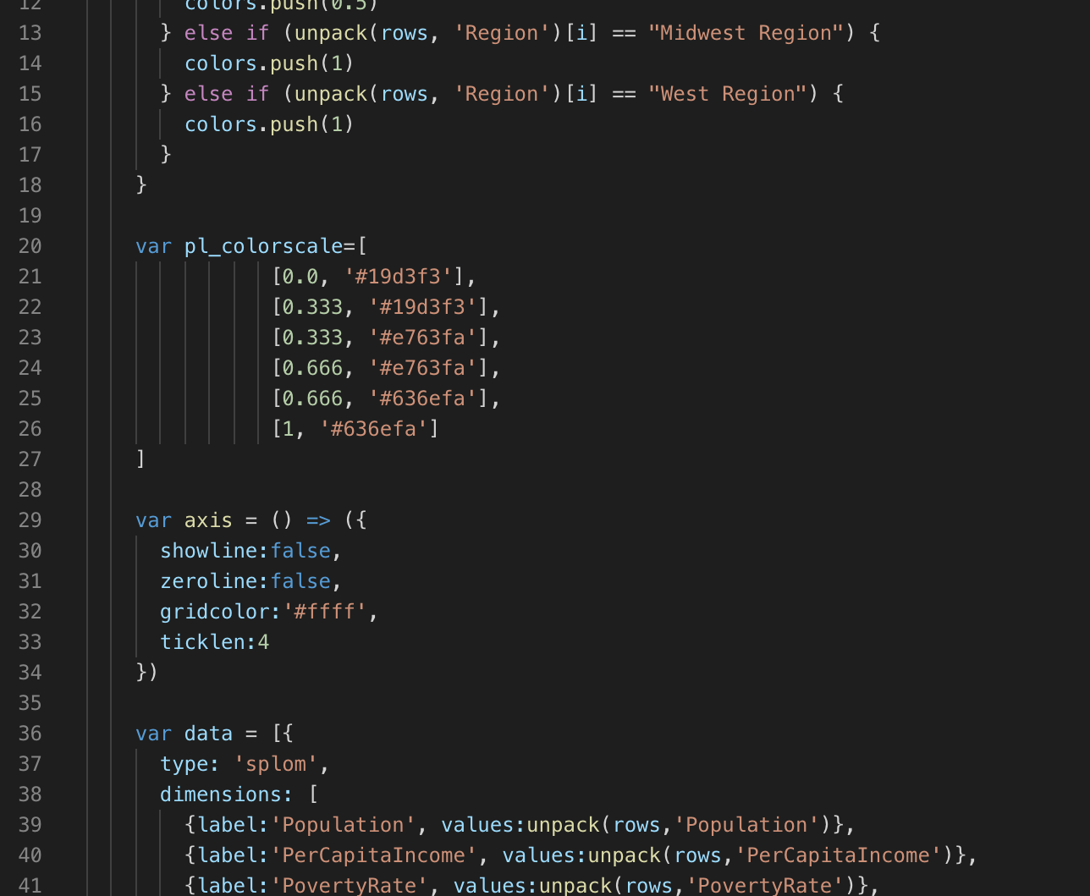
Visualization Three
Shows the correlations against the average per square foot in each of the census variables
Utilized JS, D3, etc…

Slide 13
Conclusion
The best market for our investors to invest in would be the _____ market due to its high growth potential
The market to avoid for most investors would be the _______ market due to its unappealing factors that have caused it to have the worst growth amongst all cities analyzed

